Slide 2


ENGINEERING MACHINE LEARNING
HEALTH TECHNOLOGY

Slide 3

MACHINE LEARNING for Health tech
LEARNING OUTCOMES
When the course is completed, the students are expected to be able to:
Explore and apply suitable machine learning techniques, code libraries and development tools for proof-of-concept solutions to practical tasks and for projects in the field of healthcare technology.
Compare and assess the applicability of different machine learning frameworks, data and techniques when analyzing practical problems in the field of healthcare technology.
Enter into constructive and informed dialogue about machine learning from a healthcare-technological perspective.
Present the results of analysis, design and/or implementation of machine learning in healthcare technology through brief and concise oral pitches and possibly in writing.

Slide 4
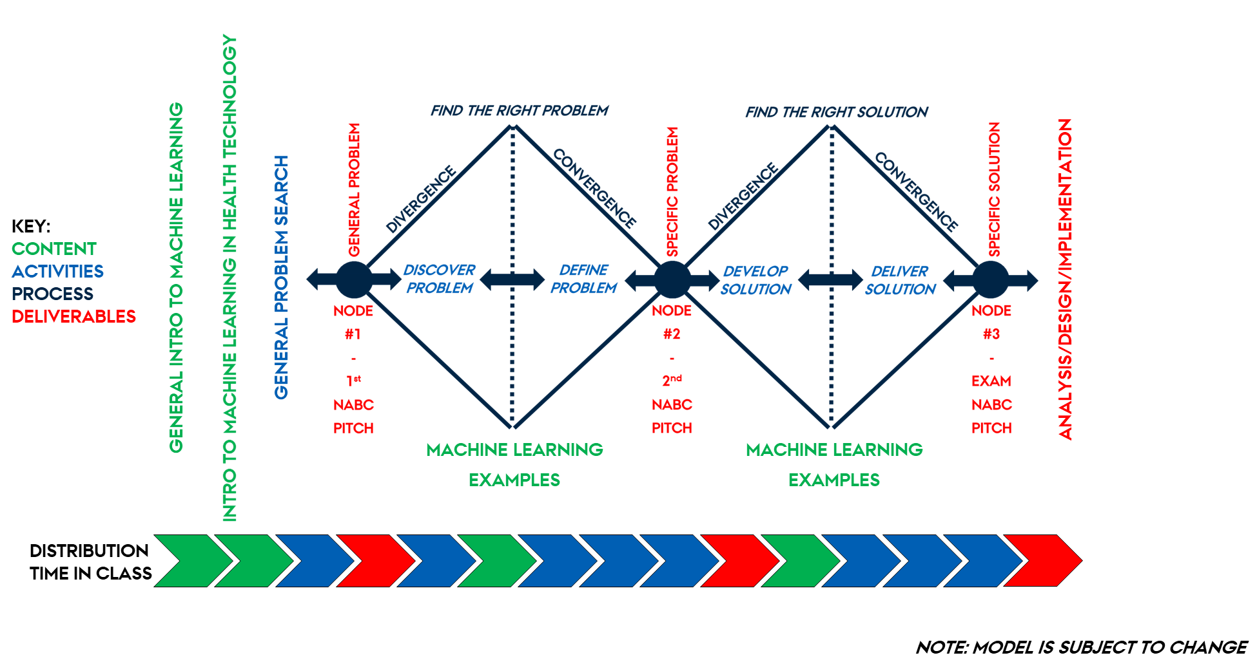
MACHINE LEARNING for Health tech

Slide 5


MACHINE LEARNING for Health tech
TEACHER

